Slide 1
Diagrammatic Dialog Design Notations & Computer Mediated Communications in HCI

Slide 2
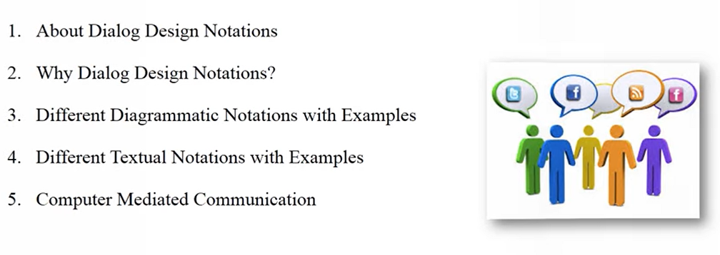
Course Outline
About Dialog Design Notations
Why Dialog Design Notations
Different Diagrammatic Notations with Examples
Different Textual Notations with Examples
Computer Mediated Communications

Slide 3

Dialog Design Notations
What is dialog?
Conversion between two or more perties.
The dialog is linked:
To the semantics of the system, what it does.
To the presentation of the system, how it looks.
Formal descriptions can be analysed:
For inconsistent actions
For difficult to reverse actions
For missing items
For potential miscuing errors.

Slide 4
About Dialog Design Notations
Dialog is the syntactic level of human computer interaction. It is rather like the script of a play, except the user, and sometimes the computer, has more choice.
Notations used for dialog description can be:
Diagrammatic notations: Easy to read at a glance
State transition networks
Petrinets
State charts
Flow charts
Jackson Structured Diagram (JSD)
2. Textual Notations: Easier for formal analysis
Grammer
Production Rules

Slide 5
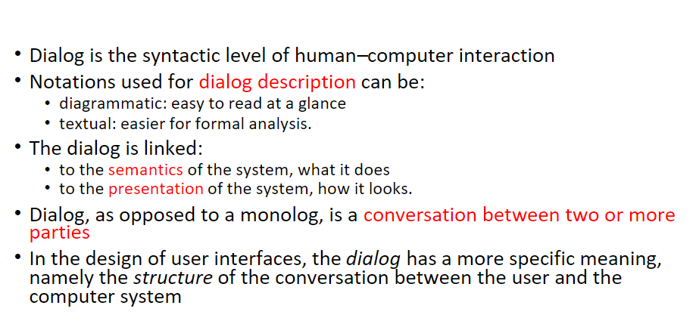
About Dialog Design Notations

Slide 6
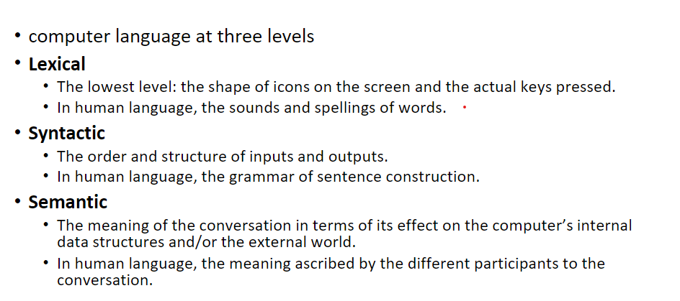
About Dialog Design Notations

Slide 7
About Dialog Design Notations
This slide is drawing an analogy between how we “speak” to a computer (write code) and how we speak to each other, breaking both into three levels:
Lexical Level
Computer side: the raw symbols—what characters you type (if, (, x, >, 0, ), { …), or even the pixels on screen that represent them.
Human-language analogy: the sounds or letters that make up words (“cat” vs. “kat”).
In practice: a compiler’s lexer (or scanner) groups characters into tokens like identifiers, keywords, operators, literals.
Example:
int x = 42;
Lexical tokens: int | x | = | 42 | ;

Slide 8
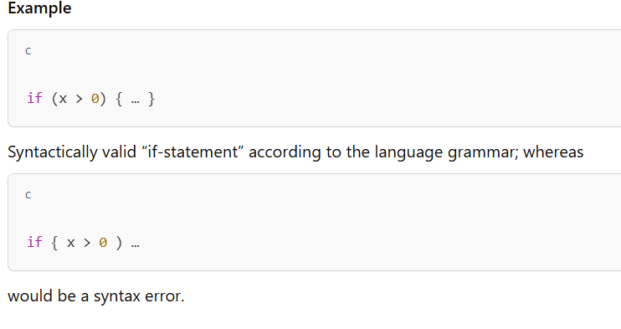
About Dialog Design Notations
2. Syntactic Level
Computer side: the structure or ordering of those tokens—how they fit together according to grammar rules.
Human-language analogy: grammar and sentence structure (“The cat sat” vs. “Sat cat the”).
In practice: a compiler’s parser checks that your tokens form a valid statement or expression.

Slide 9
About Dialog Design Notations
3. Semantic Level
Computer side: the meaning of your correctly formed code—what it actually does to the machine’s memory, data structures, I/O, etc.
Human-language analogy: what you intend to convey with your words, or how your listener interprets them.
In practice: semantic analysis (type‑checking, scope resolution), plus the runtime effect (calculations, state changes, side‑effects).
Why it matters
Compiler toolchain: these three stages—lexical analysis, syntactic parsing, semantic checking—map directly to how compilers/interpreters process your code.
Debugging: knowing which “level” an error comes from helps you fix it more quickly (typo vs. misplaced bracket vs. type mismatch).
Language design: language specifications explicitly define token sets, grammar rules, and semantic rules.

Slide 10
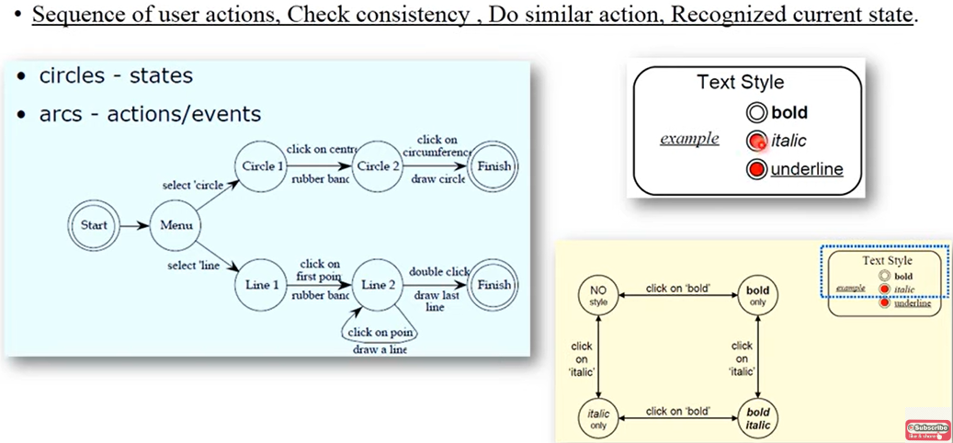
Diagrammatic notations: State Transition Networks (STN)

Slide 11
Diagrammatic notations: State Transition Networks (STN)
This image illustrates state diagrams (also called state transition diagrams), which are commonly used in user interface design and modeling user actions.
General Concepts (Top):
Circles = States
Arcs = Actions/Events (transitions between states)
Purpose: Track user actions, check consistency, perform similar actions, and recognize current state.
Left Diagram (Drawing Shapes - Circles & Lines):
This diagram models the sequence of steps a user follows to draw a circle or line:
Circle drawing flow:
Start → Menu (select 'circle') → Circle 1 (click center) → Circle 2 (click circumference) → Finish
Line drawing flow:
Start → Menu (select 'line') → Line 1 (click first point) → Line 2 (click on another point) → Finish
It reflects rubber band interactions (dynamic preview of shapes while dragging).

Slide 12
Diagrammatic notations: State Transition Networks (STN)
Right Diagram (Text Styling - Bold & Italic):
Shows the state machine for toggling text style settings.
States:
NO style
bold only
italic only
bold italic
Transitions: Occur on clicking 'bold' or 'italic' options.

Slide 13
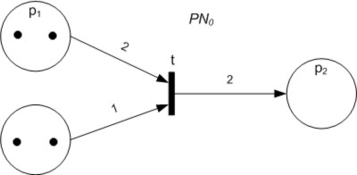
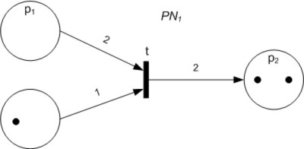
Diagrammatic notations: Petri nets
A Petri net, also known as a place/transition (PT) net.
It is a class of discrete event dynamic system.
A Petri net is a directed bipartite graph that has two types of elements: places and transitions.
Place elements are depicted as white circles and transition elements are depicted as rectangles.
A place can contain any number of tokens, depicted as black circles.
A transition is enabled if all places connected to it as inputs contain at least one token.

Slide 14
Petrinets
Petri Nets - Core Concepts
A Petri Net is:
A directed bipartite graph.
Consists of:
Places (shown as white circles)
Transitions (shown as rectangles)
Arcs (directed edges between places and transitions)
Tokens (shown as black dots inside places)
Behavioral Rules
A transition is enabled if all input places have at least one token.
When an enabled transition fires:
It consumes one token from each input place.
It produces one token in each output place.

Slide 15
Petrinets
Applications
Petri Nets are used to model:
Concurrent systems
Workflow systems
Distributed systems
Asynchronous interactions

Slide 16
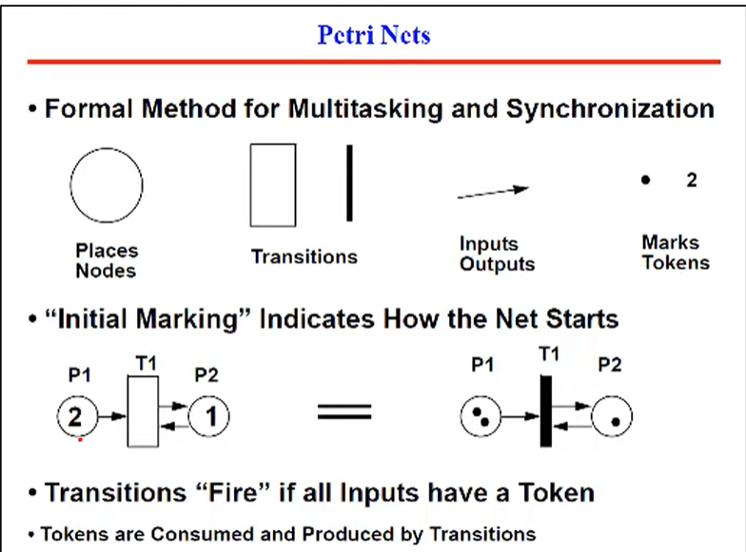
Diagrammatic notations: Petrinets

Slide 17
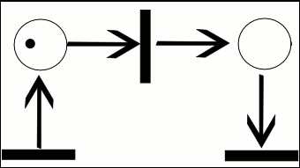
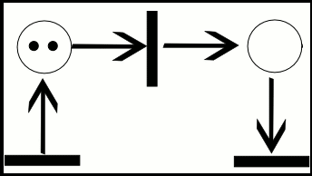
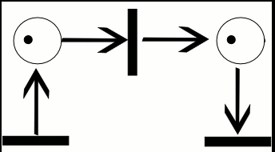
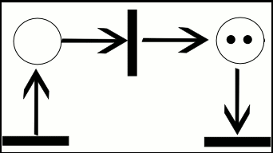
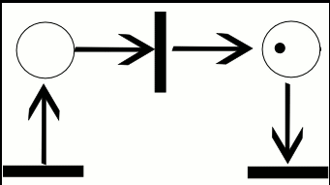
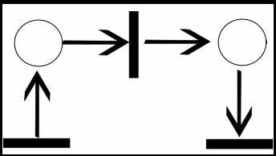
Petrinets Examples

Slide 18
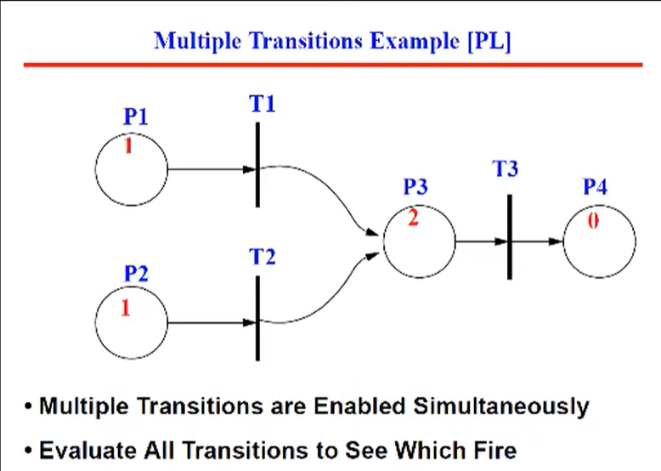
Diagrammatic notations: Petrinets

Slide 19
Petrinets
Scenario:
A coffee vending machine process involves:
Inserting a coin.
Choosing coffee.
Brewing the coffee.
Dispensing the coffee.

Slide 20
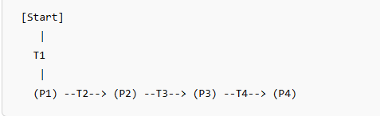
Petrinets
Coffee Machine Petri Net:
Places:
P1: Coin inserted
P2: Coffee selected
P3: Coffee brewing
P4: Coffee ready
Transitions:
T1: Insert coin
T2: Select coffee
T3: Brew coffee
T4: Dispense coffee
Flow (Token Movement Logic)
Initial State: No tokens in any place (i.e., token is outside the net).
T1 (Insert coin) fires → places a token in P1
T2 (Select coffee) fires if P1 has a token → moves token from P1 → P2
T3 (Brew coffee) fires if P2 has a token → moves token from P2 → P3
T4 (Dispense coffee) fires if P3 has a token → moves token from P3 → P4

Slide 21
Petrinets
Benefits of Using Petri Nets for This:
Visual clarity: shows steps and flow.
Detect deadlocks or inefficiencies.
Easy to simulate real-world workflows.

Slide 22
Diagrammatic notations: StateCharts
StateCharts represents complex reactive systems that extends Finite State Machines (FSM) ,
handle concurrency.
It also simplifies complex system representations.
Active states: the present state of the underlying FSM.
Basic states: these are individual states and are not composed of other states.
Super states: these states are composed of other states.

Slide 23
StateCharts
1. Why StateCharts?
Extend FSMs: Traditional FSMs can become unwieldy when you need to represent lots of states, nested behaviors, or concurrent activities.
Handle Concurrency: StateCharts let you express parallel regions (orthogonal components) so multiple “sub‑machines” can be active at once.
Simplify Complexity: By organizing states hierarchically, you avoid state‑explosion and make your models easier to read, maintain, and evolve.
2. Terminology
Term | Meaning
Active states | The set of states (possibly in different regions) that the system is currently “in.”
Basic states | Leaf nodes in the state hierarchy. They do not contain any substates.
Superstates | Composite states that do contain one or more nested states (basic or further composites).

Slide 24
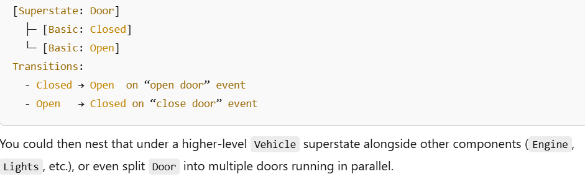
StateCharts
Benefits in Practice
Modularity: Break your system into nested pieces, each with clear responsibilities.
Reusability: Common behaviors live in superstates and apply to multiple substates.
Clarity: Visual diagrams stay manageable even as the system grows, because you can collapse or expand sections.
Maintainability: Adding or modifying behaviors often means touching only one small sub‑machine rather than reworking a huge flat FSM.
Example:

Slide 25
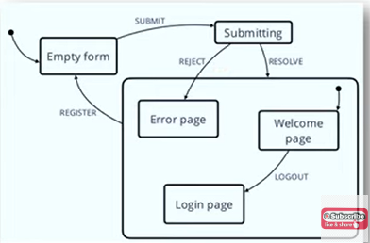
StateCharts
Here’s what this StateChart is modeling—a simple “sign‑up/login” flow with an asynchronous submission step, plus an inner composite state for the post‑submit pages:
Top‑Level States
Empty form
Initial state (the solid black dot on the far left points here).
User fills in their name/email/etc.
Submitting
Triggered by the SUBMIT event from Empty form.
Represents the async work of sending your data to the server.
(Anonymous) Composite State
Encapsulates everything that happens after the server responds.
You enter this superstate either on REJECT (error) or RESOLVE (success) from Submitting.

Slide 26
StateCharts
Inside the Composite (“Post‑Submit”) Superstate
There’s its own initial pseudo‑state (solid dot at top right) whose outgoing arrow goes to Welcome page.
Basic states within it:
Error page
Login page
Welcome page
Transitions within/into the Composite
Submitting → Error page
Labeled REJECT
If the server rejects your registration (e.g. “email already taken”), you jump straight into Error page.
Submitting → Welcome page
Labeled RESOLVE
On success, you enter the composite and—because of its default arrow—you land in Welcome page.

Slide 27
StateCharts
Error page → Empty form
Labeled REGISTER
From the error page you can go back to editing the form (to try different data).
Welcome page → Login page
Labeled LOGOUT
Once you’re “logged in” (on the welcome screen) you can log out, which takes you to a login screen inside the same composite.

Slide 28
StateCharts
Active, Basic & Superstates
Basic states: the three named rectangles (Error, Login, Welcome) are all leaf states—they don’t contain further substates.
Superstate: the big rounded rectangle groups those three. You can think of it as “the app shell” that only exists once you’ve submitted—successfully or not.
Active states: at any moment the chart is in exactly one of these:
Before submit: Empty form or Submitting.
After submit: exactly one of Error page, Login page, Welcome page.

Slide 29
StateCharts
Why This Helps
Hierarchy keeps your “post‑submit” UI pages neatly grouped, so common behaviors (e.g. global keyboard shortcuts, nav menus) could be attached at the superstate level.
Default (initial) substate means on any successful entry to that composite you automatically go to the welcome screen unless you explicitly redirect elsewhere.
Clear async handling: the SUBMIT→Submitting→(REJECT/RESOLVE) pattern cleanly separates “in‑flight” from success vs. failure logic.

Slide 30
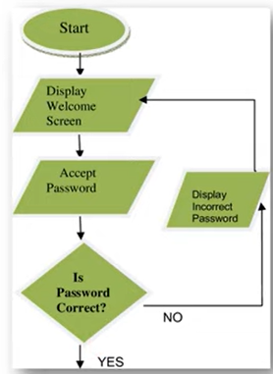
Diagrammatic notations: Flow Charts
A flowchart is a picture of the separate steps of a process in a sequential order.
A flowchart can also be defined as a diagrammatic representation of an algorithm, a step by step approach to solving a task.

Slide 31
Diagrammatic notations: JSD
JSD means Jackson Standard Design.
Used for task analysis and dialog design notations.
Less expensive and greater clarity.
For example: Personal Record System

Slide 32
Diagrammatic notations: JSD
JSD – Jackson System Development (Jackson Standard Design)
Purpose: JSD is a structured method primarily used for:
Task Analysis
Dialog Design
System Design (esp. for data-driven systems)
Key Features:
Clarity: Provides a visual and logical representation of tasks, making complex systems easier to understand.
Cost-Effective: Less expensive than more formal or heavyweight methods.
Process-Oriented: Focuses on how data moves and changes over time.
Ideal for Analysis & Design: Especially useful in early stages of system development.

Slide 33
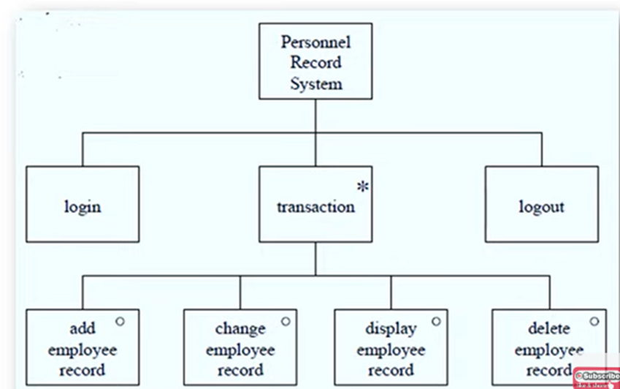
Diagrammatic notations: JSD
Used for:
Designing dialog flows in interactive systems
Mapping user tasks to system functions
Creating structured data-process diagrams
Example Application: Personal Record System
In such a system, JSD could be used to:
Break down tasks like Add Record, Update Record, Delete Record
Analyze user dialogs for searching or viewing personal data
Model the process life cycle of a "Person" object

Slide 34
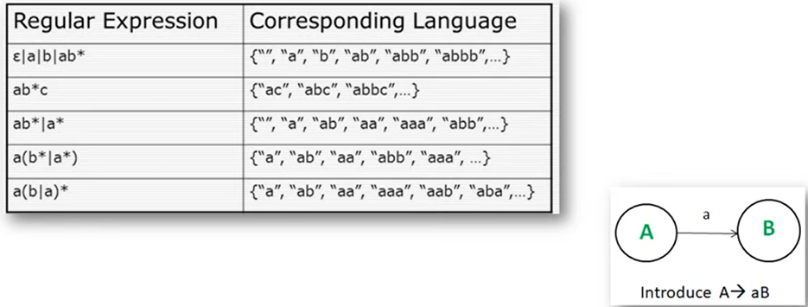
Textual Notations: Grammars
Grammars are used to describe the syntax of a programming language.
It specifies the structure of expression and statements.

Slide 35
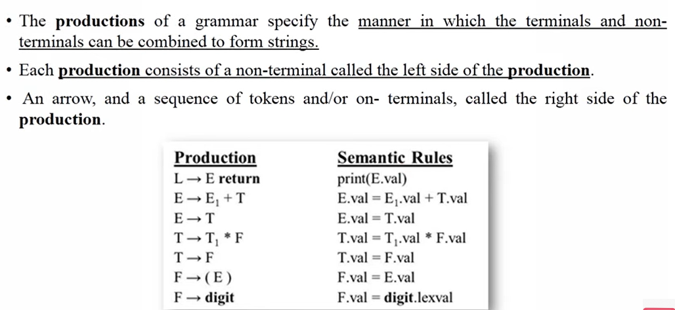
Textual Notations: Production Rules

Slide 36
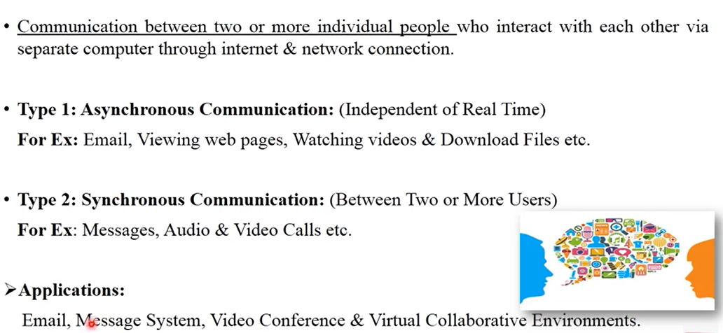
Computer Mediated Communication

Slide 37
Computer Mediated Communication
Communication between two or more individuals using separate computers or devices connected via the internet or a network. This form of communication allows users to interact, share information, and collaborate regardless of their physical location.
1: Asynchronous Communication
Communication that does not happen in real-time. Participants can respond at their convenience, which makes it flexible for different time zones or busy schedules.
Examples:
Email – Sending and receiving messages at any time.
Viewing Web Pages – Reading static or dynamic content that doesn’t require live interaction.
Watching Videos – Consuming pre-recorded content (e.g., YouTube).
Downloading Files – Getting files from the internet without real-time exchange.
Advantages:
Allows time to think before responding.
Convenient for participants in different time zones.
Ideal for documentation and formal communication.

Slide 38
Computer Mediated Communication
2: Synchronous Communication
Communication that happens in real-time, where all parties are present at the same time. It provides instant feedback and is more interactive.
Examples:
Instant Messaging – Chat apps like WhatsApp, Messenger, Slack.
Audio Calls – Voice calls over internet (e.g., Skype, Zoom, VoIP).
Video Calls – Face-to-face live communication (e.g., Zoom, Google Meet).
Advantages:
Faster response and feedback.
Feels more natural and human.
Suitable for urgent discussions or collaborative tasks.

Slide 39
Computer Mediated Communication
Applications of Online Communication
Email For formal and asynchronous communication (personal, academic, business).
Messaging Systems Instant text-based communication (e.g., SMS, WhatsApp, Telegram).
Video Conferencing Used for virtual meetings, webinars, interviews (e.g., Zoom, Teams).
Virtual Collaborative Environments Platforms where multiple users can work together in real-time, such as:
Google Workspace (Docs, Sheets, Slides)
Microsoft Teams
Trello or Asana (for task/project management)

